Slide 1
Chapter 8
The Basics of Perl
Programming the World Wide Web
Fourth edition
By Robert W. Sebesta

Slide 2
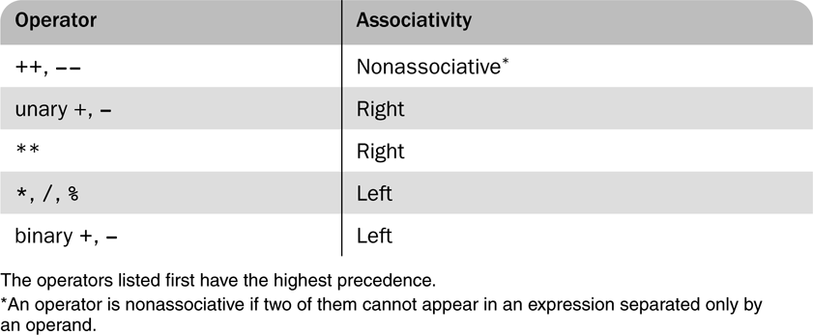
Table 8.1 Precedence and associativity of the numeric operators

Slide 3
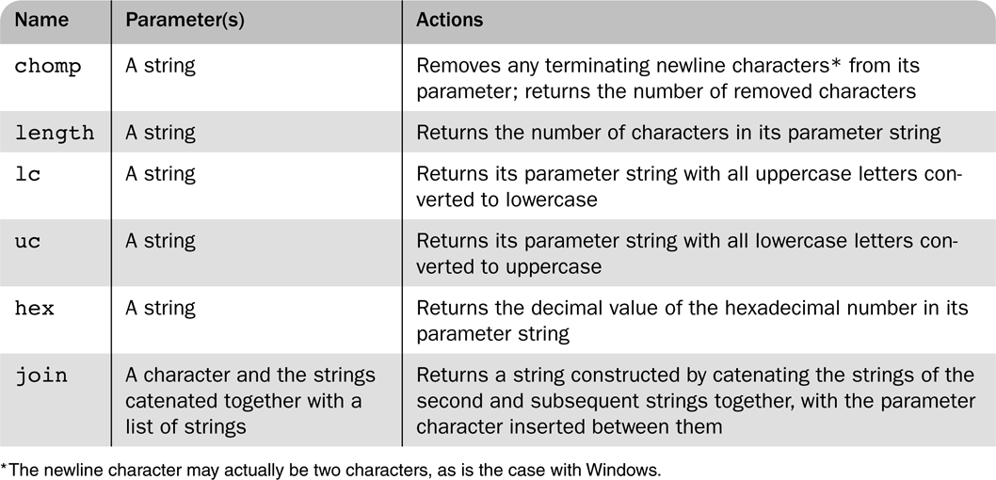
Table 8.2 String functions

Slide 4
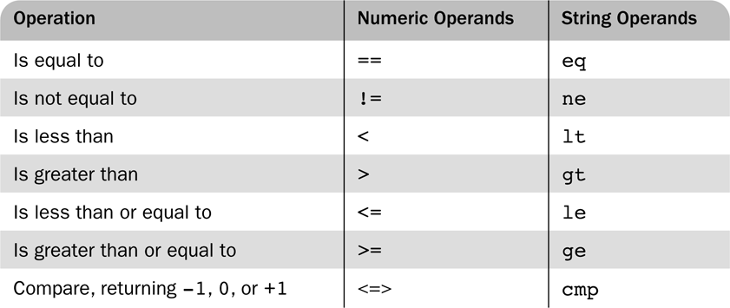
Table 8.3 Relational operators

Slide 5
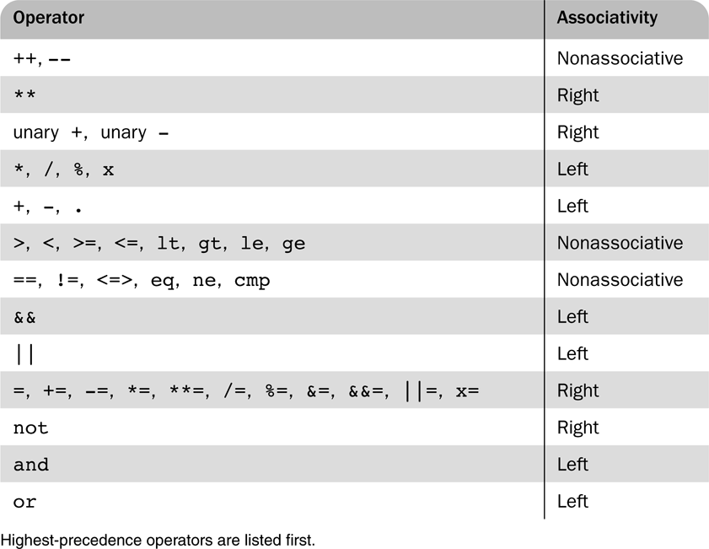
Table 8.4 Operator precedence and associativity

Slide 6
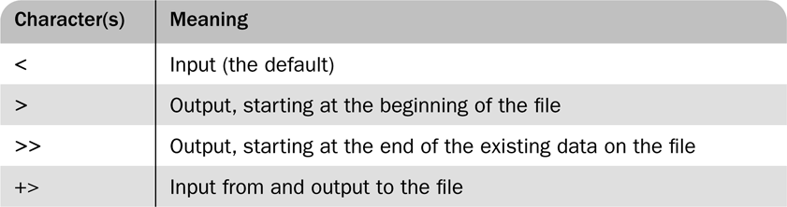
Table 8.5 File use specifications

